Slide 1
Facebook Privacy Policy
Project By:
Jahnavi Neelam
Trilok Dhanekula
Sai Siva Deekshita Chithajhallu

Slide 2
TABLE OF CONTENT
Introduction
Ensuring Trust: Privacy, Safety, and Fairness
Social Facebook Impression
Policy Coverage
What Meta Collects
How Meta Uses Your Data
Data Sharing with Partners
Data Transfers
Data Retention
Promoting Safety, Security, and Integrity
GDPR and CCPA
Cambridge Analytica Scandal
Misinformation and Harmful Content
Antitrust and Monopoly Concerns
Child Safety and Mental Health Concerns
Empowering Users: Your Privacy Rights
Conclusion

Slide 3

-Mark Zuckerberg Time (May 20, 2010)
“What people want isn’t complete privacy .... they want control.”

Slide 4
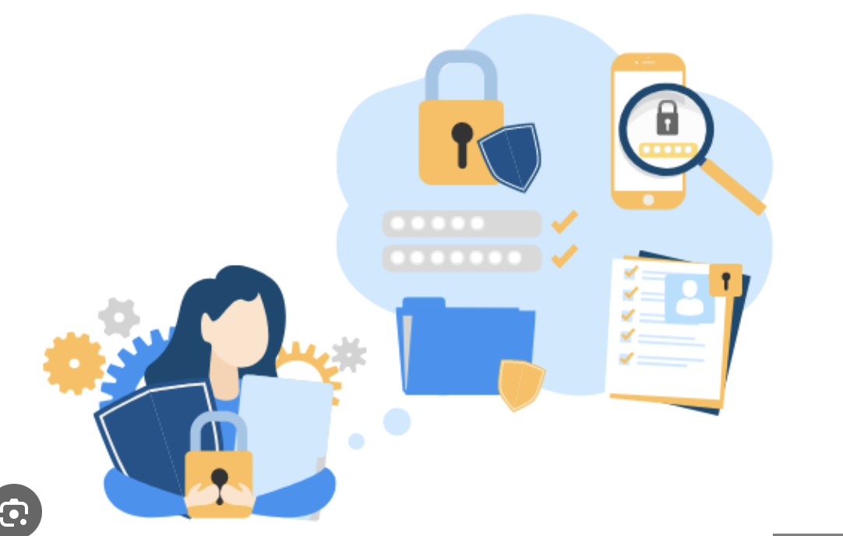
Facebook’s Global Impact: A Data Perspective
3.07B
Monthly Active users
51.48%
5.1% every year
Users In the USA
Growth rate
1.3B
Fake accounts removed/ quarterly

Slide 5
Meta’s Privacy Policy: A Comprehensive Framework
Policy Coverage
Data Handling
Data Retention
User Rights
Covers all Meta platforms and services, ensuring clarity on where the policy applies.
Describes how user data is collected, processed, and shared across Meta’s ecosystem.
Outlines how long data is stored and the safeguards for its security during retention.
Empowers users to access, manage, and delete their data through provided tools.

Slide 6
Policy Coverage
Social Media Platforms:
Facebook
Messenger
Instagram (including Boomerang and Threads)
Hardware Products:
Facebook Portal
Meta Horizon Worlds
Meta Quest (when using a Facebook or Meta account)
Commerce and Business Tools:
Shops
Marketplace
Meta Business Tools

Slide 7
Policy Coverage
Advertising and Augmented Reality:
Meta Audience Network
Spark AR
Financial Services:
Meta Pay
Meta Checkout Experiences
Other:
Facebook View

Slide 8

What Meta Collects: Data at a Glance
Your Activity and Information You Provide
Sign-Up Information: Email, phone number (required to create an account).
Content Creation: Posts, comments, photos, audio (you may choose to provide).
Usage Metrics: Time spent, app interactions (we may track this data).
Transactions: Purchases, payments (this data must be collected for processing).
Messaging Details: Sent/received content (data will include timestamps and metadata).
Friends, Followers, and Connections
Interaction Data: Tracks your interactions and their intensity (we may monitor these patterns).
Contact Details: Names and contacts (you may upload voluntarily).
Inferred Data: Derived from your network’s activities (we will analyze for recommendations).
Non-User Data: Your information might still be collected from others (e.g., through contact uploads).

Slide 9
What Meta Collects: Data at a Glance
App, Browser, and Device Information
Device Usage: Type, model, and app activity (we may record this).
Location: GPS, Bluetooth signals, IP address (even if Location Services is turned off, we can estimate your location).
Network Info: ISP, time zone (this data will be collected automatically).
Cookies: IDs and settings (we must use these for performance tracking).
Third Parties and Partners
Partner Data: Information from partner apps and vendors (this data will be shared based on agreements).
Activity Matching: Emails, cookies, device IDs (we may use these for advertising purposes).
Business Support: Communications with partners (we must share specific data for business management).

Slide 10
What Meta Collects: Data at a Glance
Not Allowing to collect specific information
What if the data isn’t identifiable?
Information with special
protections
- You won’t be able to create an account without basic details like an email or phone number.
- Certain features, like seeing friends’ posts, won’t function fully.
- De-identified or aggregated data is used without re-identifying individuals.
- This ensures privacy while still enabling data analysis.
-You might share details like religious views or sexual orientation.
-These details have special protections under your local laws.

Slide 11

How Your Data is Shared and Protected
On Meta Products
Control Over Shared Content:
Sometimes users can choose the audience for:
Posts, photos, or articles shared.
Communication and activity visibility, such as Story Views and Shop Content.
Active status visibility.
How Others Can Share Your Content:
Resharing: Shared posts can be further shared by others.
Visibility of Interactions: Comments and reactions will be visible to anyone
who can access the original content.
Tags and Mentions: Others can tag or include you in posts, photos, or videos.
Public Content Visibility:
Some information is always public (e.g., name, profile details).
Must be visible on and off Meta Products, potentially appearing in public forums or search results.

Slide 12
Collaborating Safely: Sharing with Partners
"We don't sell any of your information to anyone, and we never will."
Partners must follow rules on how they use and disclose shared information.
Advertisers and Audience Network Publishers
Data shared: Ad interactions, demographics, and views.
We don’t share: Contact details like your name or email unless you give permission.
Partners Using Analytics Services
Data shared: Interaction counts, demographics, and how users engage with partner services.
Partners Offering Goods or Services
Data shared:
Information needed to complete transactions.
Security details like device info.
Any information required by regulations or explicitly shared by you.

Slide 13
Collaborating Safely: Sharing with Partners
Measurement Vendors
Engagement data, including ad views and interactions, must be shared for analytics.
Marketing Vendors
Device identifiers or other unique data will be shared to optimize ad performance.
Service Providers
The exact types of information shared are not specified, but they should follow Meta’s guidelines.
Third Parties – External Researchers
Information shared with researchers does not specify the exact types but must align with Meta's data policies.
Users can manage or restrict data sharing through privacy tools.
Other Third Parties
Data can be shared:
In response to legal requests or to comply with laws.
To prevent harm and improve safety.
The specific data shared is not always disclosed.

Slide 14

Global Transfers: Securing Your Information
Regulatory Frameworks
EU-U.S. Data Privacy Framework (DPF):
Enables safe data transfers between the EU, UK, Switzerland, and the U.S.
Transfers must comply with EU, UK, and Swiss laws.
Organizations are required to self-certify adherence and publicly commit to these principles.
Reasons for Global Data Transfers
To operate and improve services as stated in Meta’s terms.
To fix, analyze, and enhance products.
Safeguards for Information Transfers
Mechanisms for Protection:
Standard contractual clauses and adequacy determinations by authorities.
Use of encryption to ensure safety during transfers over public networks.
Reliance on laws ensuring equivalent protections for data transferred to the U.S. and other regions.
Participation Requirements
U.S. organizations must self-certify adherence to the Data Privacy Framework.
Data protection efforts should align with EU, UK, and Swiss privacy standards.

Slide 15
Why Meta Uses Your Data: Insights and Innovations
To Provide, Personalize, and Improve Products
Must personalize features, content, and recommendations.
Will use data for ads and to develop, research, and test products.
Always aim to improve Meta Products.
To Promote Safety, Security, and Integrity
Should monitor for compliance and suspicious activity.
Protect health, ensure security, and prevent threats.
Address biases, combat spam, and maintain integrity.
To Provide Measurement, Analytics, and Business Services
Insights into engagement levels and user demographics.
Will analyze how users interact with partner content.
Tailored Ads and Off-Facebook Activity: Will use off-Facebook activity to deliver personalized ads matching user preferences.
Send updates and marketing messages based on preferences.
Should provide customer support and seek input on products.
To Communicate

Slide 16
Why Meta Uses Your Data: Insights and Innovations
Advanced-Data Practices
Public user data is used to train AI models like Llama 2.
Highlight regional opt-out options for AI training data.
Tailored Ads
Data is used to personalize ads, including off-Facebook activity.
Tools for managing tailored ad preferences.
To Research and Innovate for Social Good
Enhance public welfare, advance tech, and promote safety

Slide 17

Beyond Users: Managing External Data
Contact Matching: Address Books (Process names, phone numbers, and emails to suggest friends).
User Connectivity: Recommend new users as potential connections.
Security and Analytics
Will monitor and investigate suspicious activity.
Conduct analytical processes to ensure security.
Non-User Data Sharing
Can share collected data with other Meta Companies to improve functionality.
Non-User Data Retention
Retained as long as necessary for operations.
Sometimes kept longer for legal, regulatory, or safety purposes.

Slide 18

Privacy RIGHTS under US privacy Laws
Right to Know
Right to Request Correction
Right to Request Deletion.
(Didn’t mention the obligation to notify third
parties for deletion requests)
Right to Opt Out of Targeted Advertising
Right to Non-Discrimination
* Didn’t mention the new right to limit the use
and disclosure of sensitive personal
information, or the Right to Opt-Out of
Automated Decision-Making Technology

Slide 19
Where Your Data Lives: Retention and Compliance
"We will keep information for as long as we need it"
To provide products, comply with legal obligations, or protect user interests.
Storage Based on Necessity
Operational Needs:
Profile information, photos (if not deleted), and security data are retained as long as the account exists.
Feature Functionality:
Vanish Mode: Messages disappear after being read or a set period.
Legal Compliance:
Data must be retained to:
Prevent harm or investigate violations.
Ensure safety and protect Meta's rights, property, or products.
User Control
Data will be kept until users explicitly request deletion.
Data retained in backups for up to 90 days after deletion requests.
Backup retention supports disaster recovery and compliance needs.

Slide 20
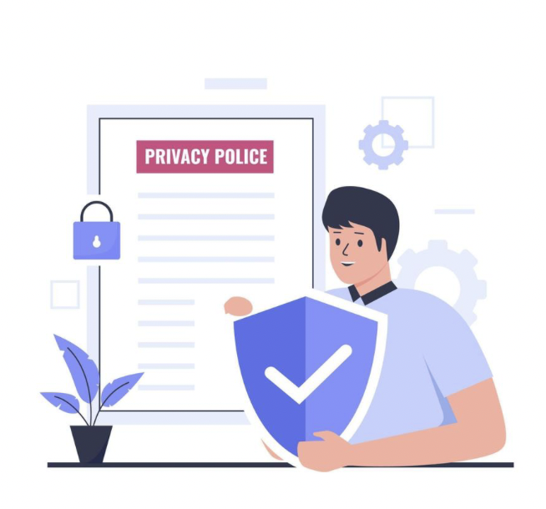
Legal Frameworks Shaping Privacy Rights
Children's Online Privacy Protection Act (COPPA)
April 21, 2000
California Online Privacy Protection Act (CalOPPA)
July 01, 2004
California Consumer Privacy Act (CCPA)
January 01, 2020
General Data Protection Regulation (GDPR)
May 25, 2018

Slide 21

Facebook Privacy Regulations (COPPA)
Effective Date: April 21, 2000.
Key Provisions: Protects children under 13 by requiring parental consent before collecting their data.
Developers must evaluate apps for child-directed content using factors like subject matter, animations, and activities.
Apps primarily for children cannot use Facebook Audience Network SDKs.
Why It Matters: Ensures Meta complies with regulations for child safety and avoids misuse of children's data.

Slide 22
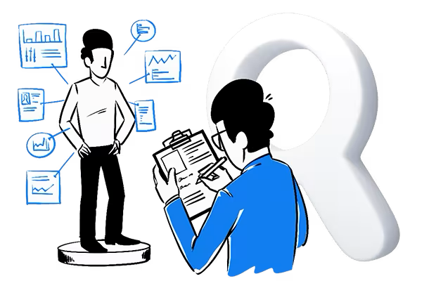
Facebook Privacy Regulations (CalOPPA)
Effective Date: July 1, 2004.
Key Provisions:
Must display privacy policies clearly on websites and apps.
Applies to apps collecting Personally Identifiable Information (PII), such as names, addresses, and emails.
Failure to comply within 30 days will result in violations.
Why It Matters: Sets the standard for privacy disclosures to users, especially in California.

Slide 23
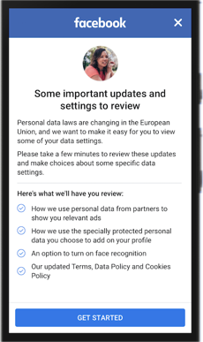
Facebook Privacy Regulations (GDPR)
Effective Date: May 25, 2018.
Key Provisions: Legal Bases for Processing Data:
Consent: Freely given and revocable by users.
Legitimate Interests: Businesses must pause processing if a user objects.
Contractual Necessity: Data processing must be essential for the service.
Provides transparency, control, and accountability over data usage.
Mandates Meta to update compliance and collaborate with privacy regulators.
Why It Matters: GDPR imposes strict privacy regulations, ensuring user control and data protection.
Penalties: 4% of global turnover or €20M, whichever is higher

Slide 24
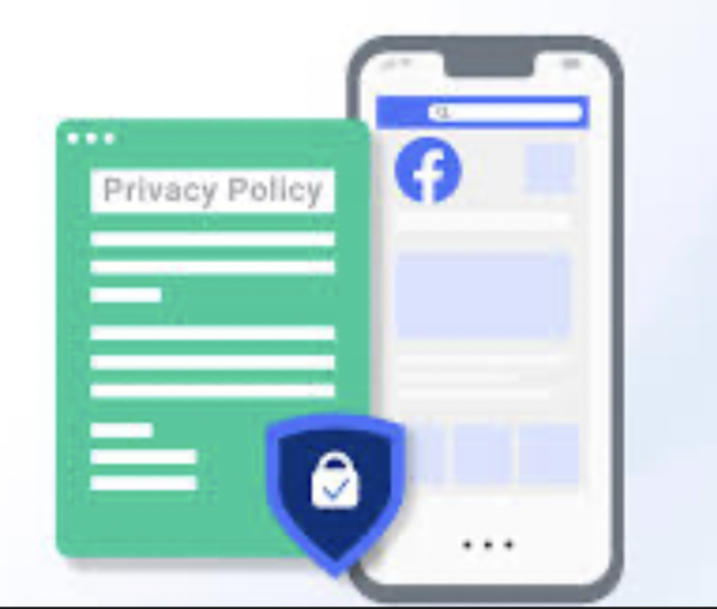
Facebook Privacy Regulations (CCPA)
Effective Date: January 1, 2020.
Key Provisions: Rights Granted to Users:
Right to Know: What data is collected and how it’s used.
Right to Delete: Users can request deletion of personal data.
Right to Non-Discrimination: Users cannot face discrimination for exercising their rights.
Businesses must disclose data categories and purposes.
Introduced Limited Data Use (LDU): Automatically applies privacy rules for users in California, Colorado, and Connecticut from July 01, 2023.
Why It Matters: Provides more control over personal data and sets clear boundaries for businesses.
Fines: $2,500 per unintentional violation. $7,500 per intentional violation

Slide 25
How does CCPA & GDPR affect Facebook advertising
Aspect | CCPA | GDPR
Who It Applies To | Profit entities processing personal data of California residents must: - Have $24M+ annual revenue. - Hold data of 50,000+ consumers. - Derive at least half of revenue from selling personal data. | Applies to any organization processing personal data of EU residents, even if the organization is outside the EU.
Consent Basis | Users can opt-out of data collection, sharing, or selling. | Users must opt-in for data collection.
Enforcement | Will apply from January 1, 2020. | Always in force since May 25, 2018.
Penalties | - $2,500 per unintentional violation. - $7,500 or actual damages for intentional violations. | - 4% of global turnover or €20M, whichever is higher. - 2% of global turnover for minor infractions.
Rights of Individuals | - Right to request information. - Right to data portability. - Right to opt-out. - Right to access data. - Right of deletion. - Right of disclosure. | - Right to be informed. - Right to access and rectification. - Right to restrict processing. - Right to erasure and data portability. - Rights over automated decision-making.

Slide 26
Facebook Data Breach, Privacy & Security Challenges
2018: Breach of Integrity
Facebook admitted to mishandling user data.
87 million user records were collected without consent by Cambridge Analytica.
The data was used predominantly for political campaigns.
March 2019: Violent Videos Spread
Facebook struggled to halt the spread of footage from the New Zealand mosque shootings.
The shootings resulted in dozens of deaths, and 1.5 million copies of the video were removed within the first 24 hours.
Facebook’s systems should have been more effective in preventing the spread of such harmful content.
May 2019: Billions of Fake Accounts
Facebook removed 2.2 billion fake accounts between January and March 2019.
These accounts were used to spread misinformation, manipulate elections, and join groups to promote deceptive narratives.
Facebook must strengthen systems to combat fake profiles.
2023: Children’s Privacy Protection Violation
U.S. regulators accused Facebook of misleading parents.
Allegations included failing to protect children’s privacy on the Messenger Kids app.
Facebook should prioritize stricter compliance with children’s data protection regulations.

Slide 27
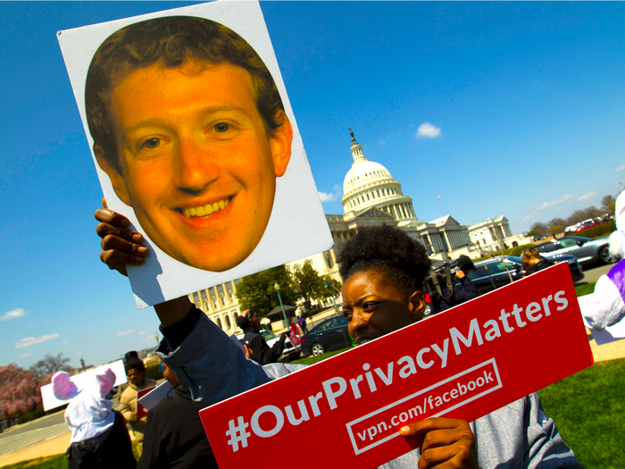
Facebook Data Breach, Privacy & Security Challenges
Cambridge Analytica: A Breach of Trust (2018)
Policy Breached: Facebook Platform Policy (unauthorized third-party data access).
User Data Misused: 87 million users' data harvested for political ads without consent.
Fixes: Restricted third-party app access and strengthened privacy controls.
Penalty: $5 billion fine (FTC).

Slide 28
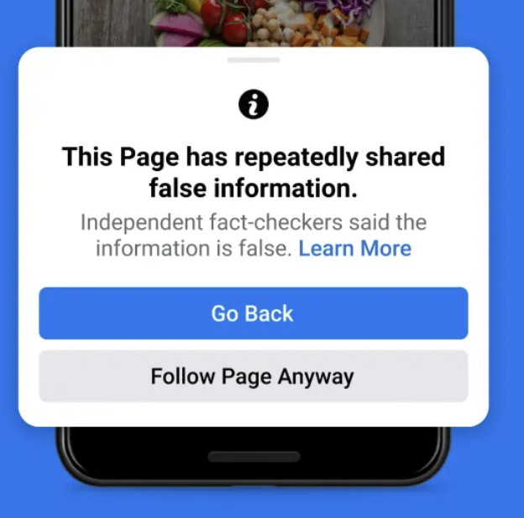
Facebook Data Breach, Privacy & Security Challenges
The Fight Against Misinformation (2019-2021)
Policy Breached: Community Standards (failed moderation of harmful content).
User Data Misused: Platform used to amplify misinformation on COVID-19 and elections.
Fixes: Enhanced AI moderation, partnered with fact-checkers, and published transparency reports.
Penalty: No financial penalty, but regulatory threats and reputational damage.

Slide 29
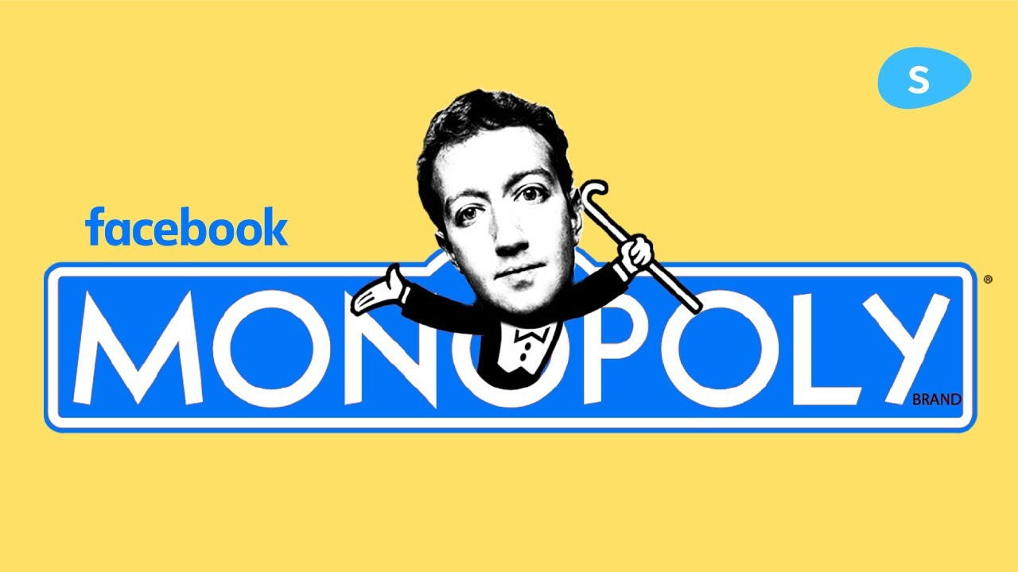
Facebook Data Breach, Privacy & Security Challenges
Antitrust Allegations: Is Facebook Too Big? (2020-2021)
Policy Breached: Antitrust laws (monopolistic acquisitions).
User Data Misused: Data from acquired platforms consolidated market dominance.
Fixes: Increased transparency and shifted focus to metaverse development under Meta.
Penalty: No fines yet; FTC lawsuit seeks divestitures of Instagram and WhatsApp.

Slide 30
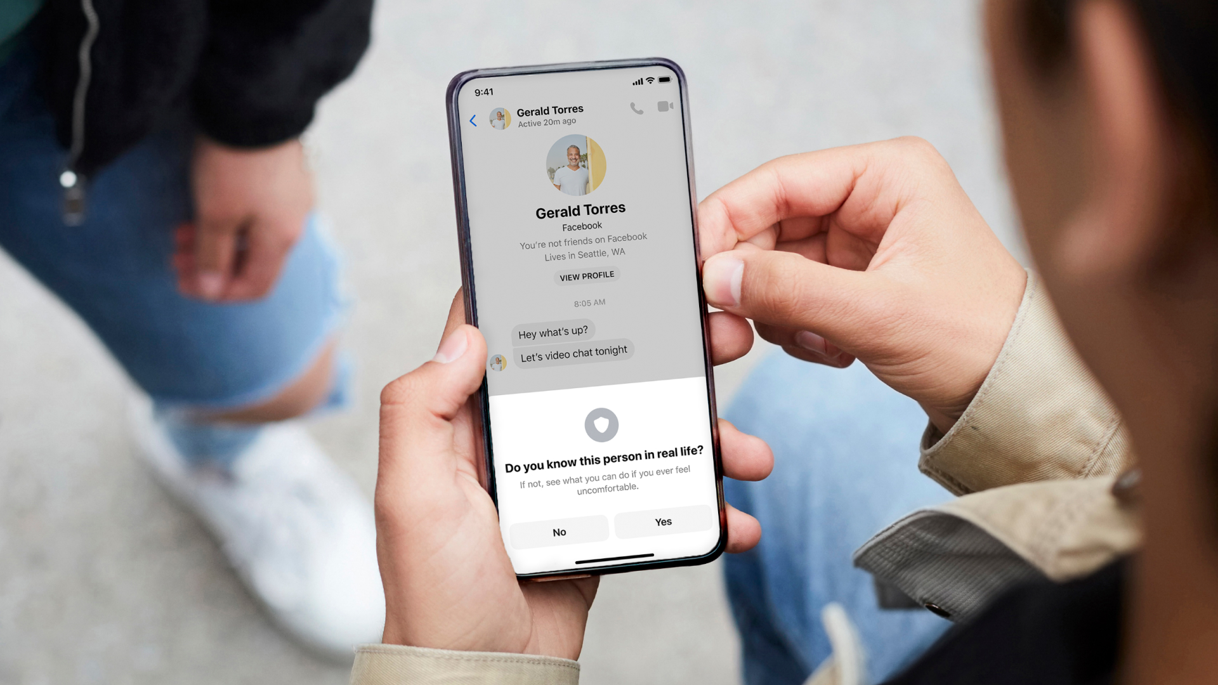
Facebook Data Breach, Privacy & Security Challenges
Protecting Children on Instagram (2021-2022)
Policy Breached: COPPA (failure to protect minors' data).
User Data Misused: Collected teenage user data and exposed minors to harmful content.
Fixes: Launched parental controls, age verification, and mental health resources.
Penalty: $400 million fine for violating COPPA.

Slide 31



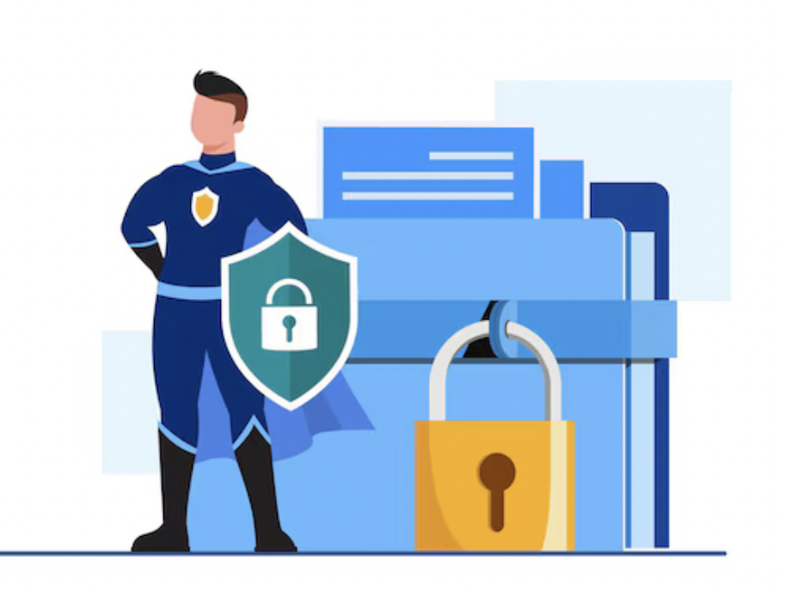

Ensuring Trust: Privacy, Safety, and Fairness
Purpose Limitation
Data must be processed only for limited, clearly stated purposes that provide value.
Data Minimization
Collect and create the minimum amount of data needed for specified purposes.
Data Retention
Data should only be kept as long as it is required for stated purposes.
External Data Misuse
Protect data from abuse, accidental loss, and unauthorized access.

Slide 32

Ensuring Trust: Privacy, Safety, and Fairness
Transparency and Control
Data must be processed only for limited, clearly stated purposes that provide value.
Data Access and Management
Collect and create the minimum amount of data needed for specified purposes.
Fairness
Data should only be kept as long as it is required for stated purposes.
Accountability
Protect data from abuse, accidental loss, and unauthorized access.

Slide 33

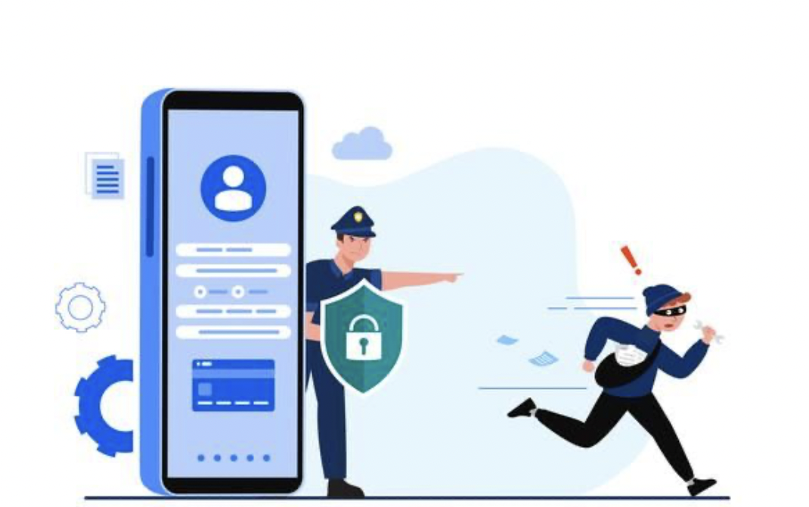
Fighting Against Online Exploitation
7/1/2023 - 12/31/2023
Reviewed and removed over 21,000 Facebook Groups that violated child safety policies.
2020 - 2023
Disrupted 37 abusive networks and removed nearly 200,000 accounts linked to these networks.
8/1/2023 - 12/31/2023
Disabled more than 2.6 million accounts for violating child sexual exploitation policies.
8/29/2023 - 12/31/2023
Facebook took action on over:
2.2 million accounts on Facebook.
1.4 million accounts on Instagram.
These accounts violated child safety policies.

Slide 34
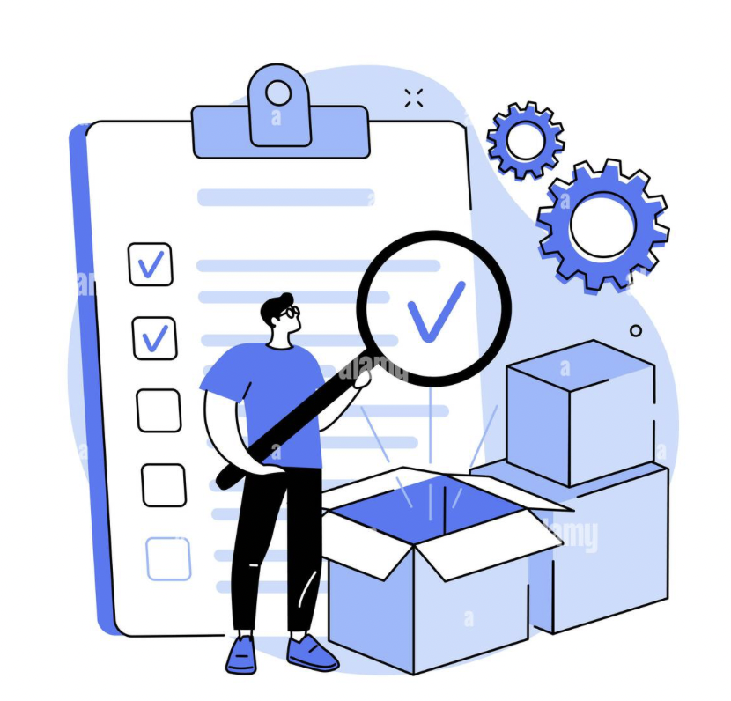
Empowering Users: Your Privacy Rights
User Control
You have the right to access and download your personal data stored by us.
You can manage your privacy by using Facebook’s settings.
You also can delete your account or specific information if desired.

Slide 35
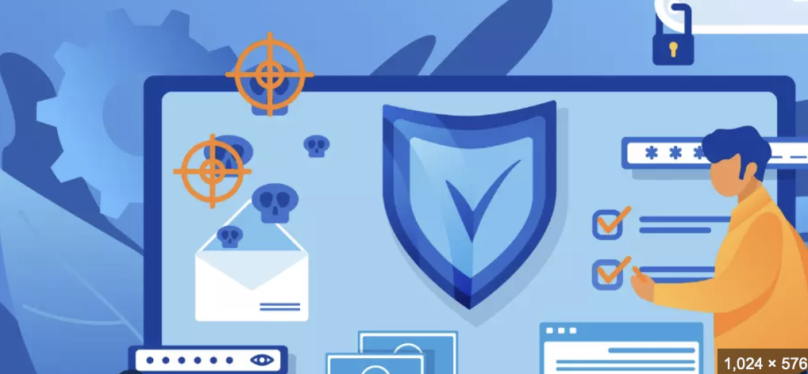
Highlighted Privacy Checkup tools
Review Settings
Easily access and update who can see your posts, profile details, and activities.
Control Sharing
Adjust how your data is shared with third parties, including apps and websites linked to Meta
Ad Preferences
Manage preferences for personalized ads and control how your activity influences ad targeting
Account Security
Check and enhance security features such as:
Two-factor authentication.
Login alerts to monitor unauthorized access.

Slide 36
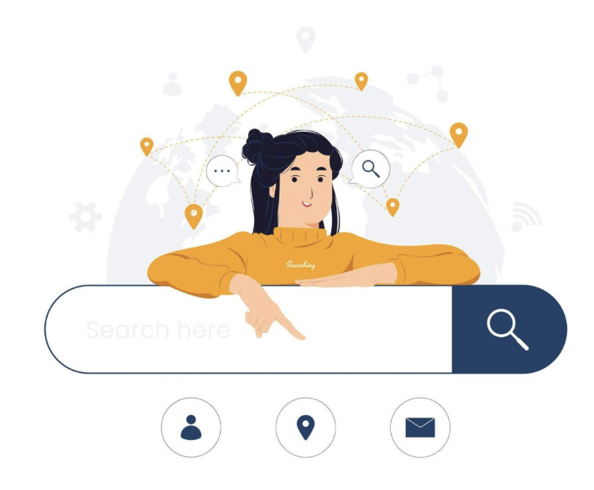

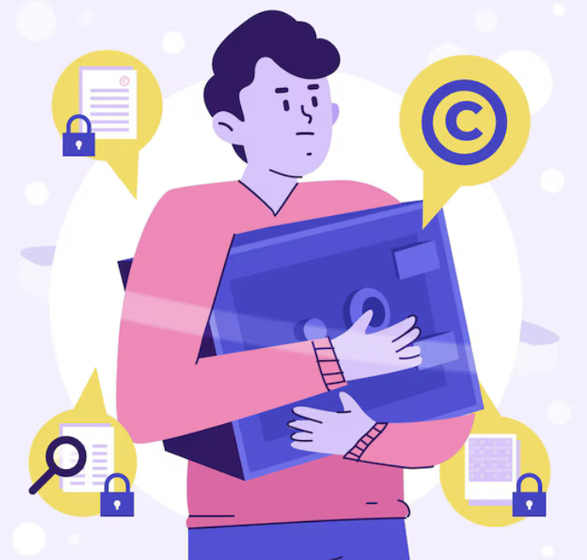
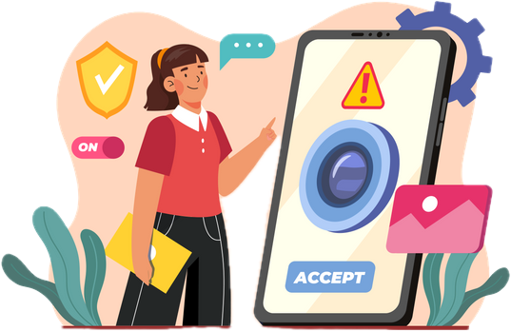
Empowering Users: Your Privacy Rights
Who Can See What You Share
How People Can Find You on Facebook
Your Ad Preferences on Facebook
How to Keep Your Account Secure
Ensure your password is strong and secure.
Enable two-factor authentication for extra protection.
Activate login alerts to monitor account access.
Manage visibility of profile details, posts, and stories.
Use blocking tools to control unwanted interactions.
Control who can send you friend requests.
Decide if your phone number and email can be used for searches.
Adjust how your profile appears on search engines.
Understand how ads are personalized for you.
Manage your profile information and its use in ads.
Control visibility of your social interactions in advertising.

Slide 37
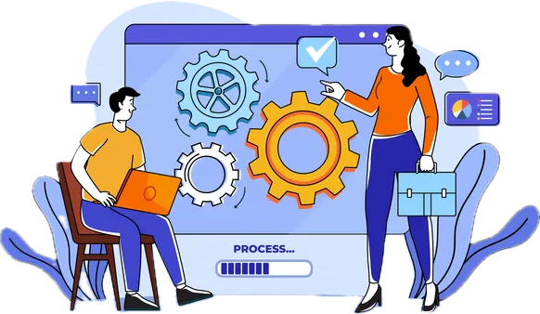
How Can You View and Manage Your Information?
Off-Facebook Activity
includes data businesses or apps share with Facebook about your interactions with them.
Data and the Internet
Much of your online activity generates data.
Sometimes, businesses share this data with Facebook.
Data Sent to Facebook
Data can help businesses target relevant audiences for ads.
Data Under Your Control
You can see a summary of data Facebook receives from other apps and websites.
Off-Facebook Activity Management
A tool giving users more control over shared data.
Can disconnect specific activities.
Can clear previous activity.
Can manage future activity.

Slide 38
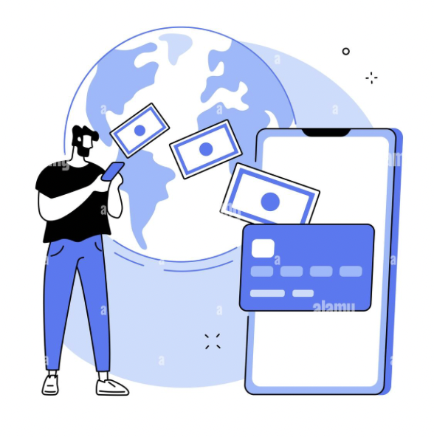
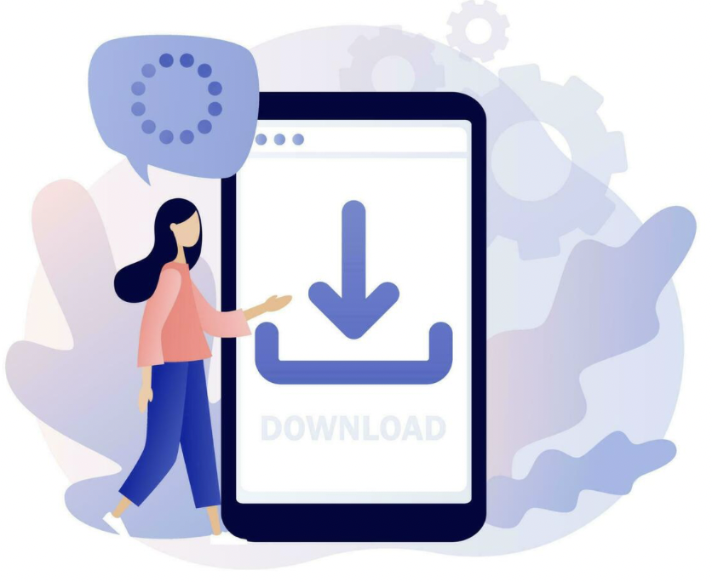
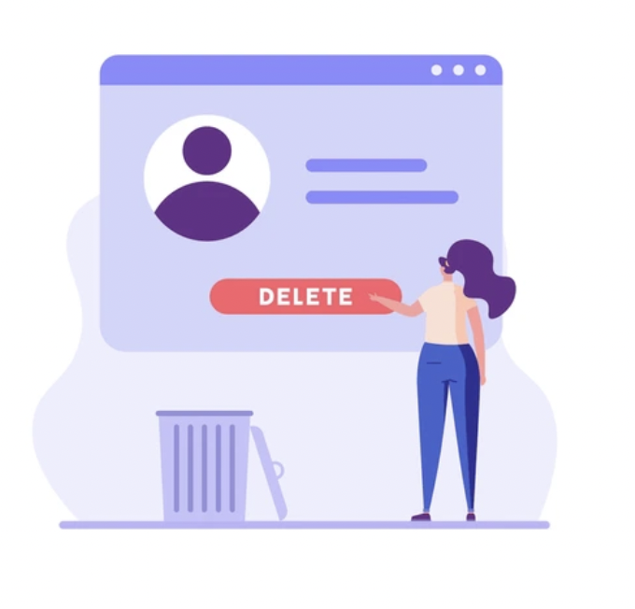
Port, Download, and Delete Your Information
Port Your Information
In certain cases, and under applicable laws, you have the right to transfer your data to another service.
Download or Transfer Your Information
You can download your shared content, activities, and collected data.
You can also transfer a copy of your information to another service.
Delete Your Information or Account
You can delete specific data or permanently remove your account.
It may take up to 90 days for your account deletion request to be processed.
Backup removal may also take up to an additional 90 days for disaster recovery.

Slide 39
Empower yourself with knowledge, safeguard your data, and take control of your digital journey. Thank you!!!!

